Slide 1
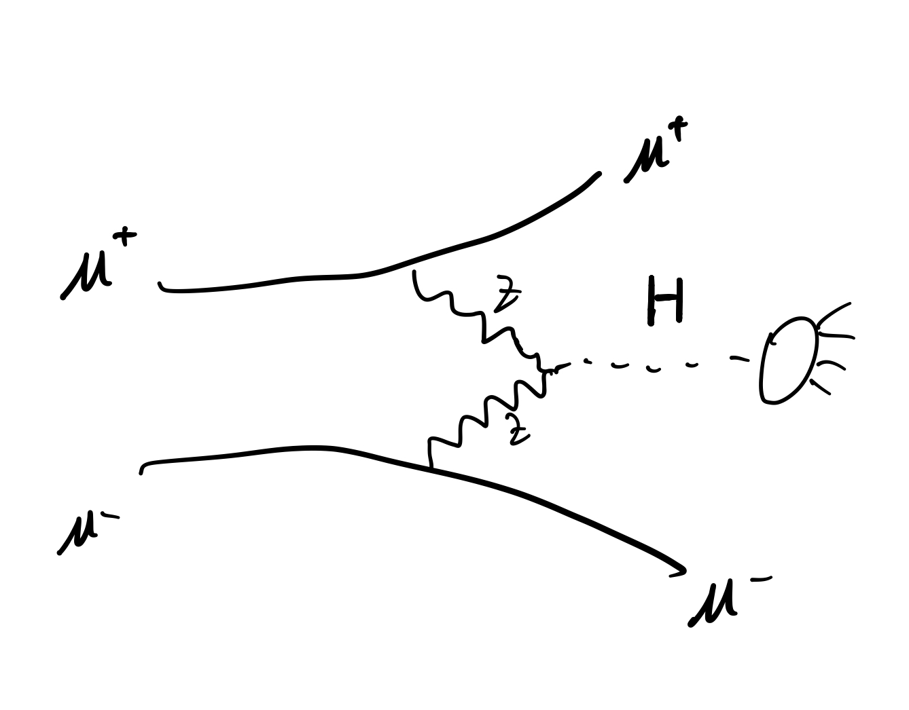

HZZ precision measurement
6/27/2023
Forward detector
Two ForwardMuons are visible.
$$2.5<η\left(μ\right)<4 or 6 or 8$$
$$m_{H}^{2}={\left[\left(10000, 0, 0, 0\right)−μ^{+}−μ^{−}\right]}^{2}$$

Slide 2
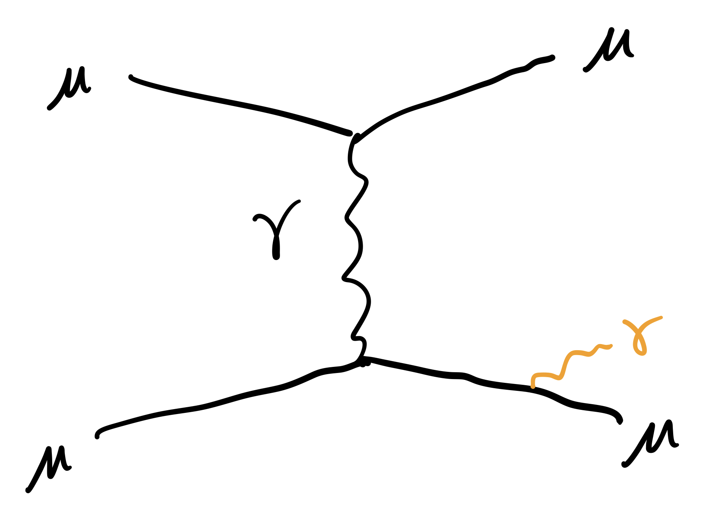
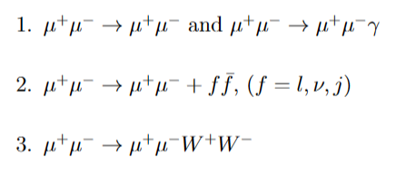
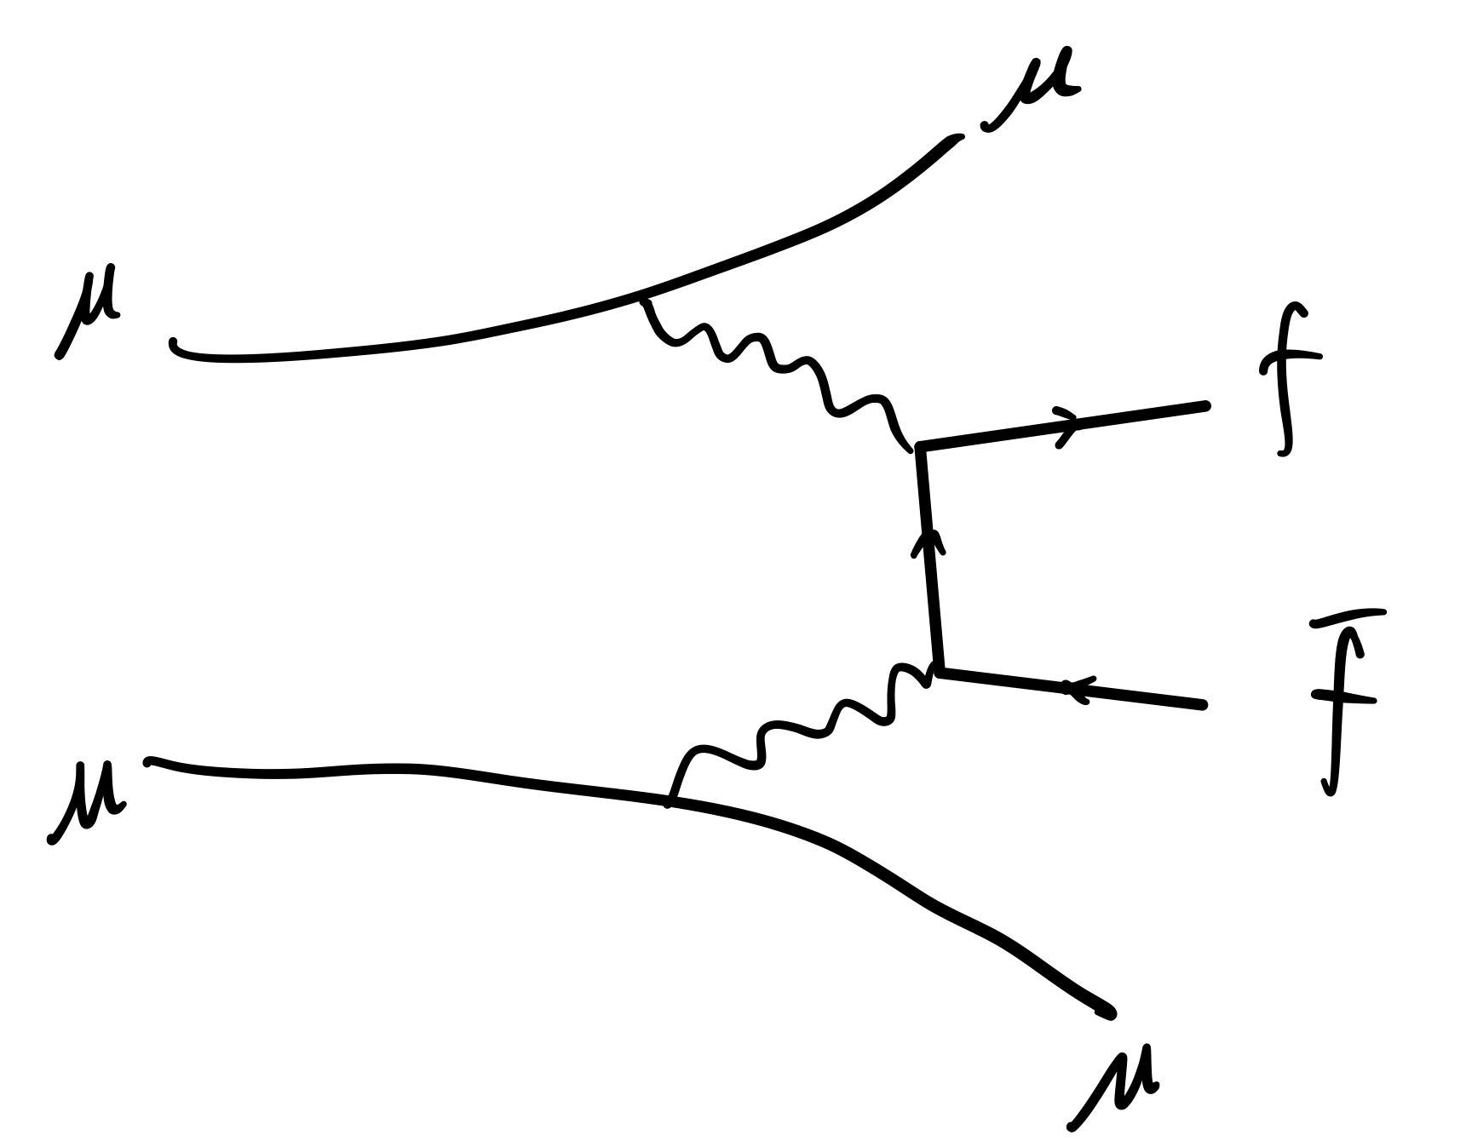
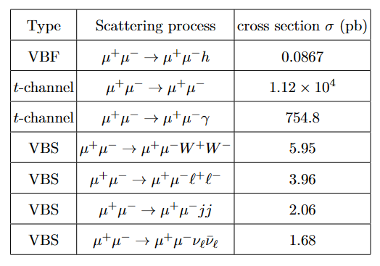
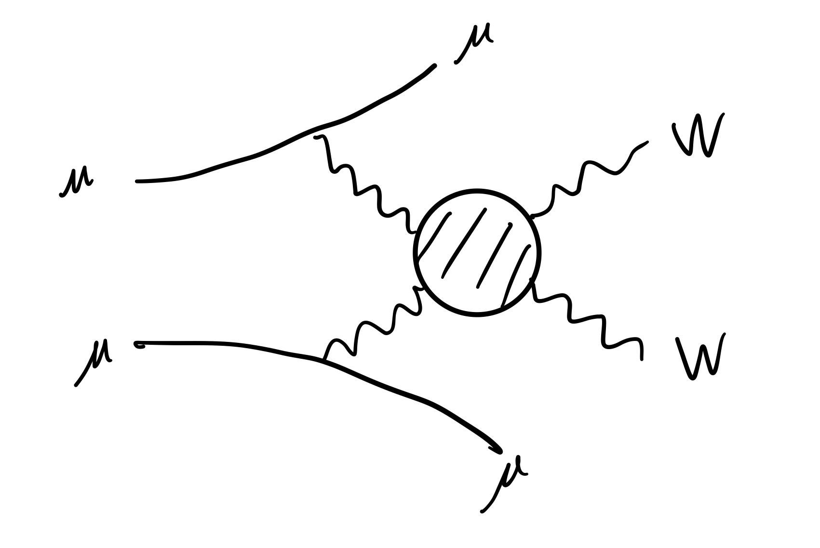
Bkg
Signal

Slide 3
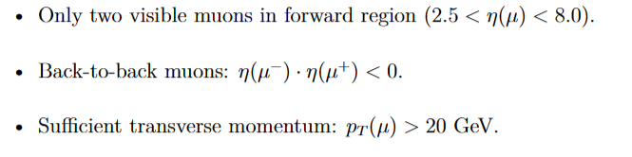
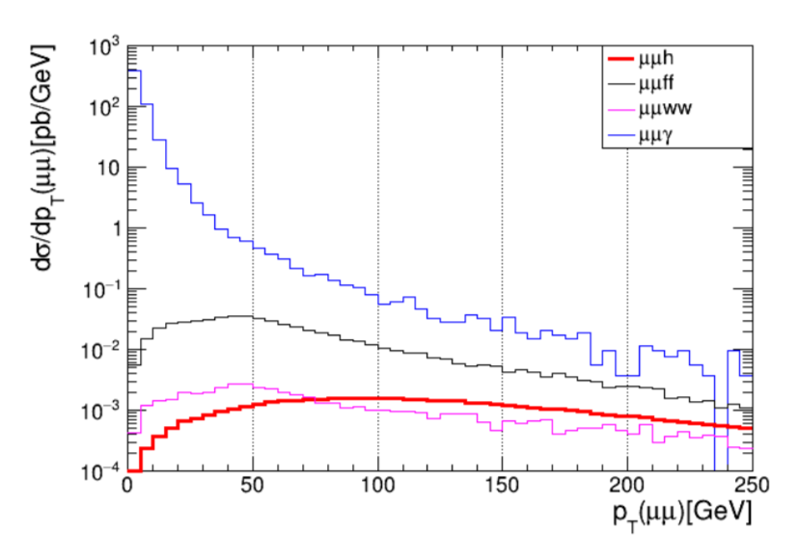
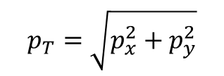

After pre-selection:
$$p_{T}\left(μμ\right)>50 GeV$$
$$p_{T}=\sqrt{p_{x}^{2}+p_{y}^{2}}$$

Slide 4
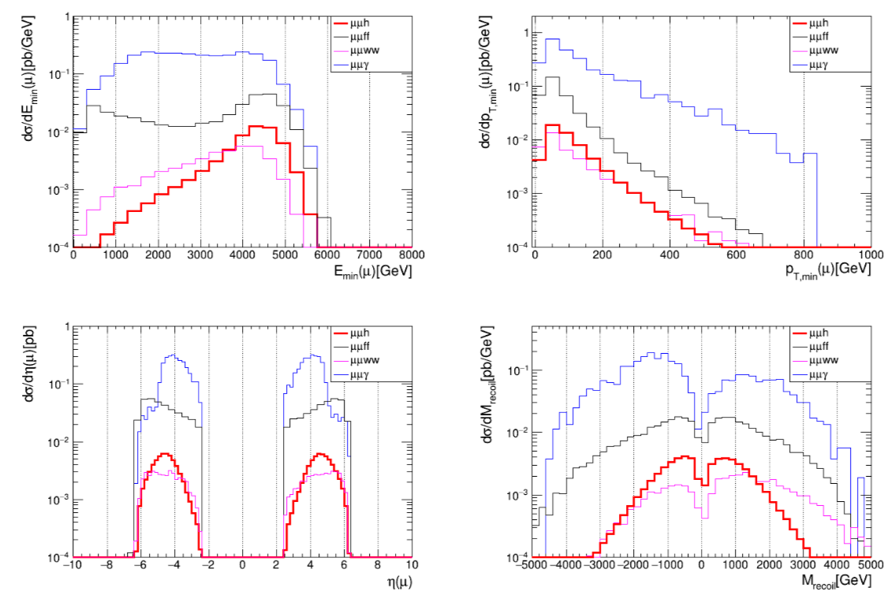

After $p_{T}\left(μμ\right)>50 GeV$
Not 125 GeV
Because the resolution for high energy forward muon is too bad

Slide 5
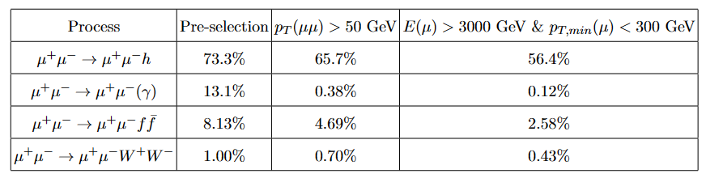
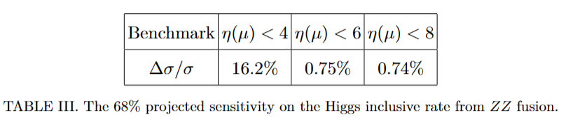
Cutflow table

Slide 6
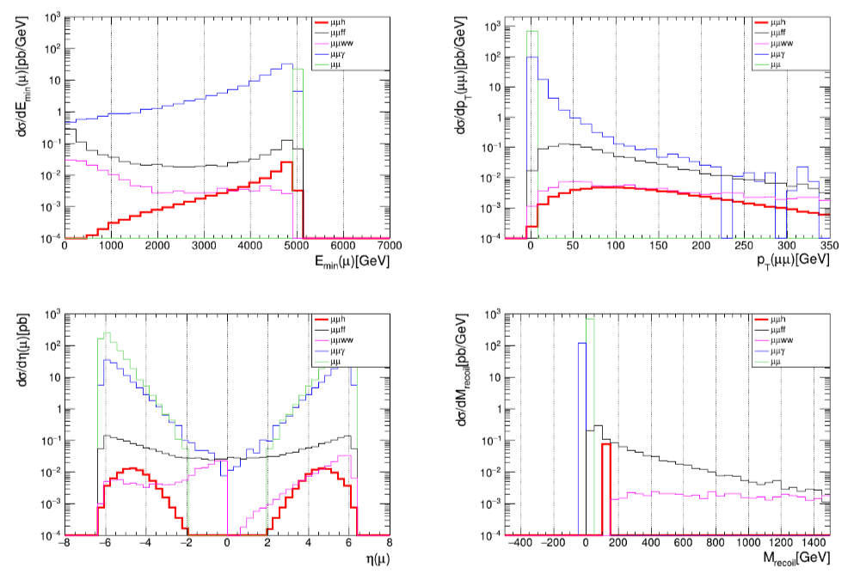
Parton level

Slide 7
HZZ precision measurement
7/13/2023
Two ForwardMuons are visible. $2.5<η\left(μ\right)<4 or 6 or 8$

Slide 8
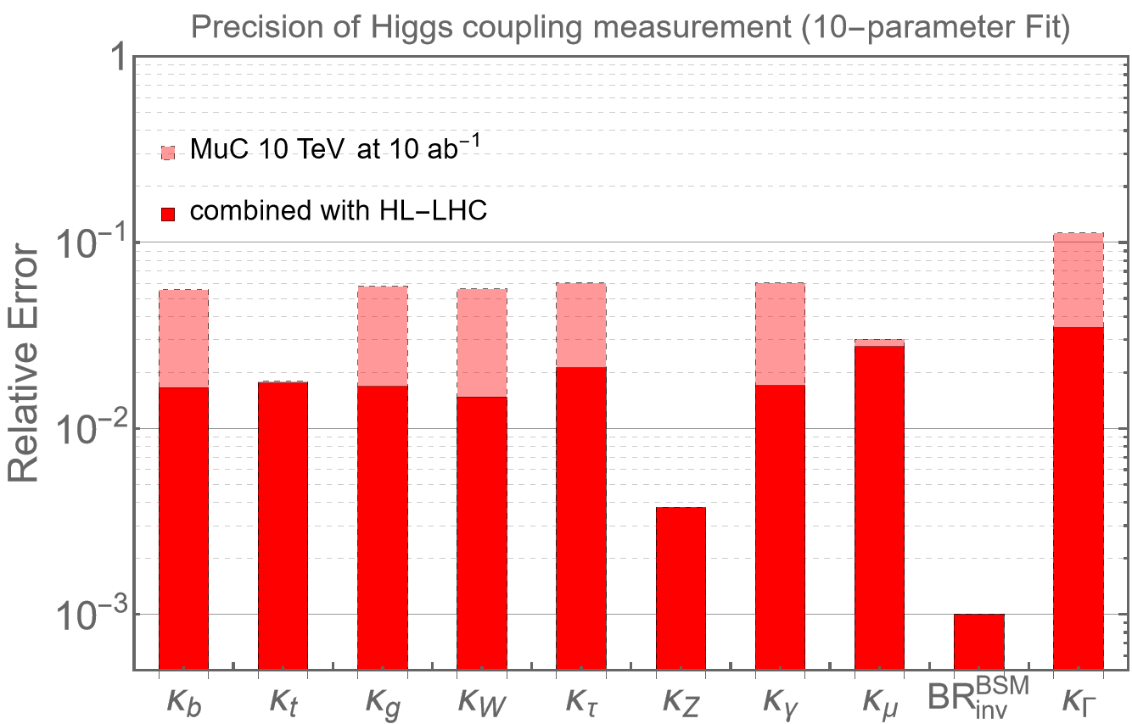
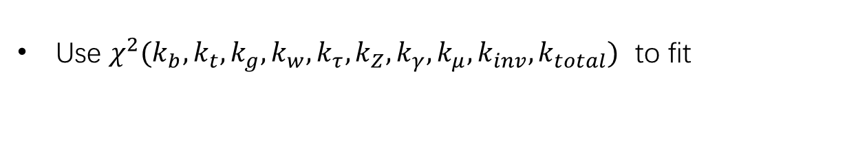

Higgs 10-parameters fit
MuC:
Matthew Forslund and Patrick Meade. Arxiv:2203.09425
M. Ruhdorfer, E. Salvioni, A. Wulzer. Arxiv:2303.14202 (invisible Br)
Ishmam’s result. (VV>H*>tt)
2008.12204.pdf (arxiv.org) (WW:ZZ)
Our result. (HZZ)
Use $χ^{2}(k_{b},k_{t},k_{g},k_{w},k_{τ},k_{Z},k_{γ},k_{μ},k_{inv},k_{total})$ to fit
HL-LHC:
GuidelinesCouplingProjections2018 < LHCPhysics < TWiki (cern.ch)
Invisible decays of the Higgs boson at the HL-LHC: experimental overview - On behalf of ATLAS and CMS H invisible teams (cern.ch)
Relative error=$\frac{1}{2}(bound_{upper}−bound_{lower})$

Slide 9
